Slide 1
电力电子理论与方法

Slide 2
电力电子变换装置的分类
1. DC/DC
2. DC/AC
3. AC/DC
4. AC/AC

Slide 3
直流变换器的分类
ƀ 不隔离的直流变换器：可分为单管、双管和四管。
◎单管：Buck 、Boost、Buck/Boost、Cuk、Zeta和Sepic；
◎双管：双管串接的升降压式(Buck/Boost)变换器；
◎四管：全桥直流变换器(Full bridge converter) 。
ƀ 隔离的直流变换器：单管、双管和四管
◎单管： Forward 、Flyback ；
◎双管：双管Forward 、双管Flyback ；
◎四管：Full bridge converter。

Slide 4
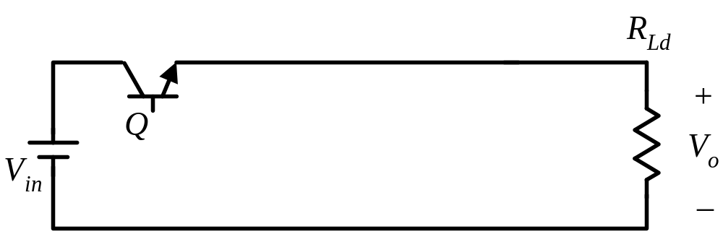

Linear DC Converter
设计要求：
V_{Q} = 100-50 =50(V)
V_{in} = 100V
V_{o} = 50V
I_{o} = 10A
P_{Q} = V_{Q} I_{Q} = 5010 =500(W)
Too Low
Efficiency!!!
η = V_{o}I_{o}/V_{in}I_{o} = V_{o}/V_{in}
= 50/100 = 50%

Slide 5

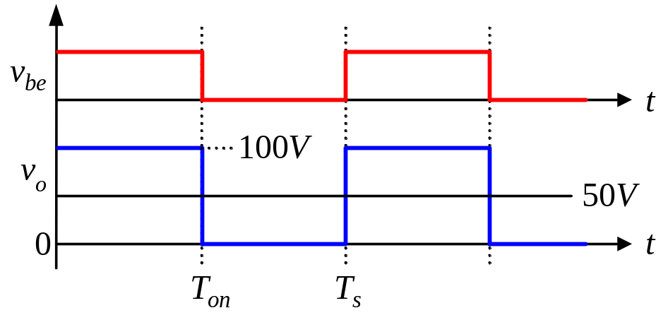
Switching-Mode DC Converter
设计要求：
Q on: P_{Q(on)} = V_{ces} I_{o} ≅ 0
Q off: P_{Q(off)} = V_{in} I_{ceo} ≅ 0
V_{in} = 100V
V_{o} = 50V
I_{o} = 10A
P_{loss} ≅ 0
η ≅ 100%
So High
Efficiency!!!

Slide 6
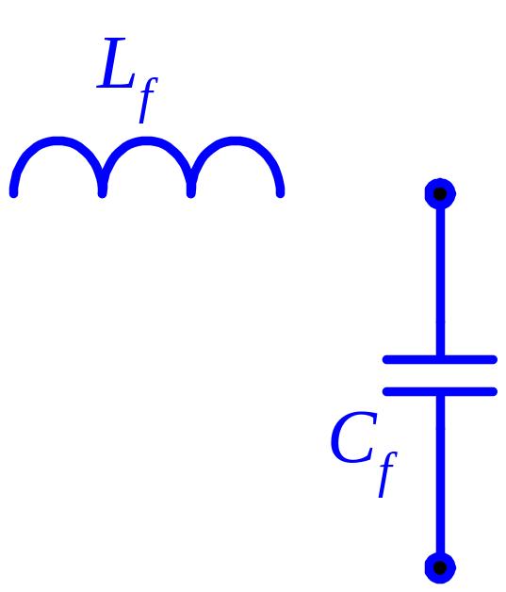

Derivation of Buck Converter
filter the high-frequency content
freewheel diode
D

Slide 7
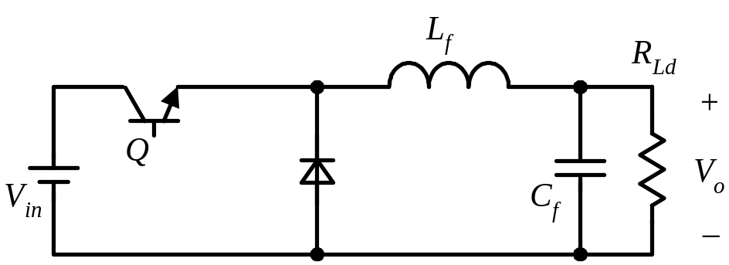
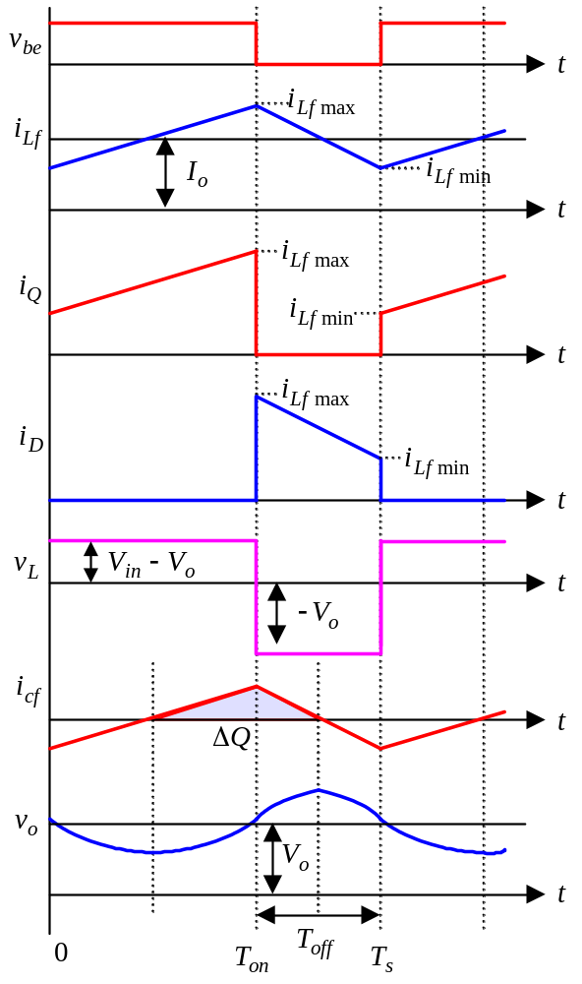
Operation Principle of Buck Converter: CCM
Q ON
Q OFF
V_{o} / V_{in} = D

Slide 8
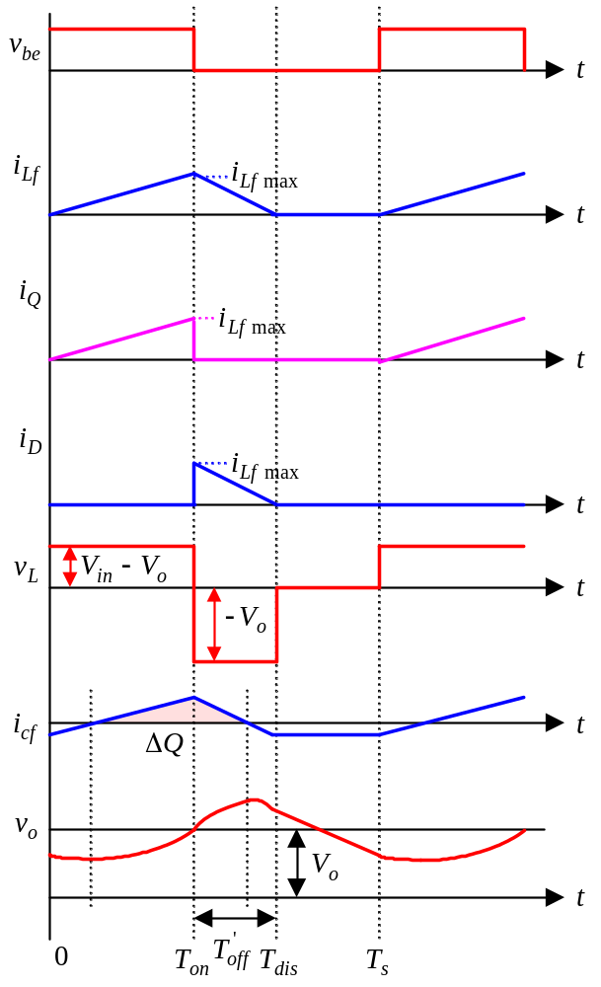
Operation Principle of Buck Converter: DCM
Q ON
Q OFF
Q OFF

Slide 9
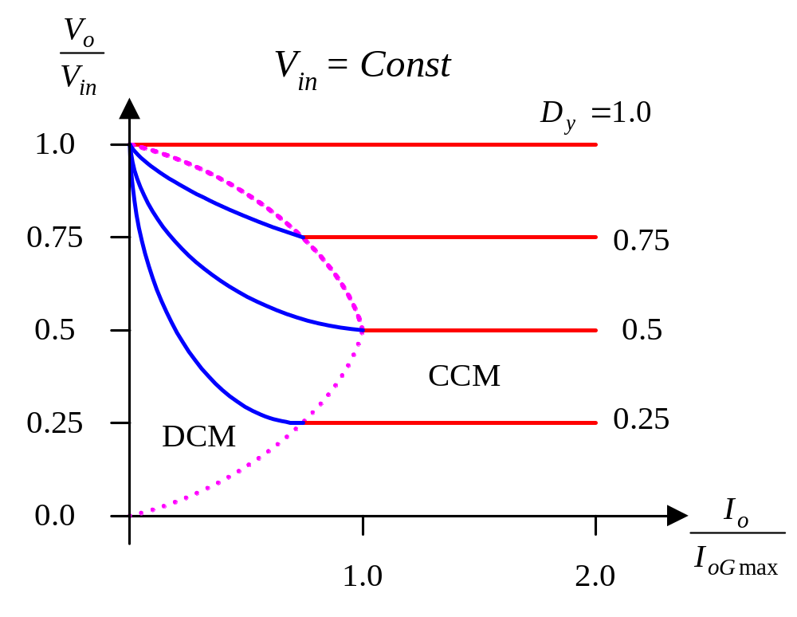
Voltage Conversion Ratio

Slide 10
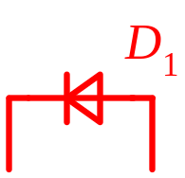
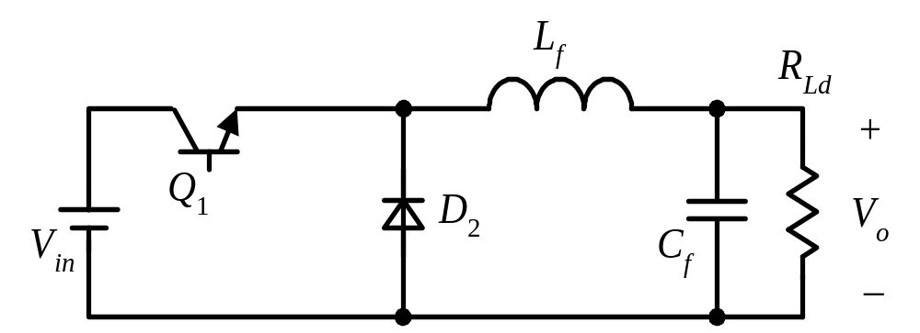
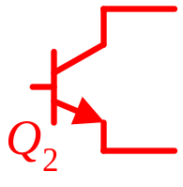
Buck Converter with Bi-Direction Switches

Slide 11
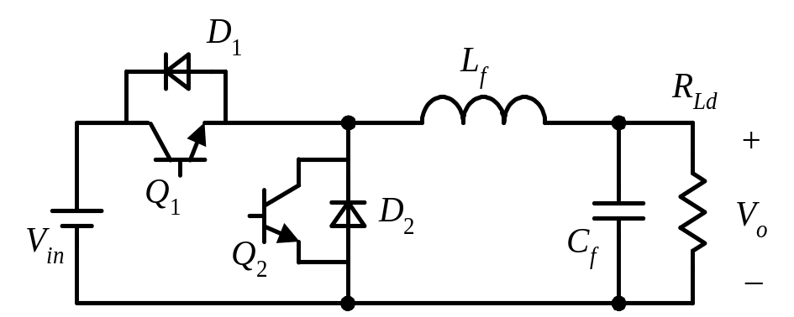
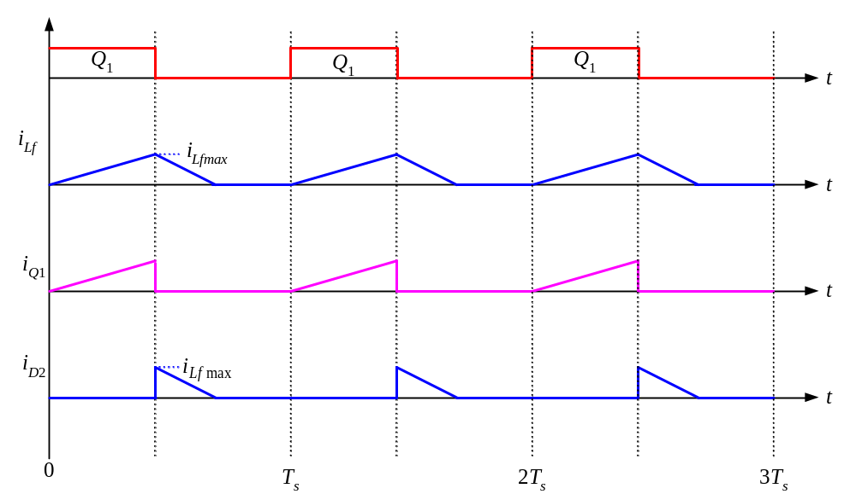



Buck Converter with Bi-Direction Switches
Q₁ OFF;
Q₂ ON.

Slide 12

Buck Converter with Bi-Direction Switches
Q₁ ON
(D₁ Conduct);
Q₂ OFF.

Slide 13

Buck Converter with Bi-Direction Switches
Q₁ ON;
Q₂ OFF.

Slide 14
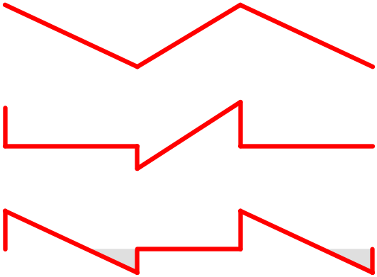
Buck Converter with Bi-Direction Switches

Slide 15
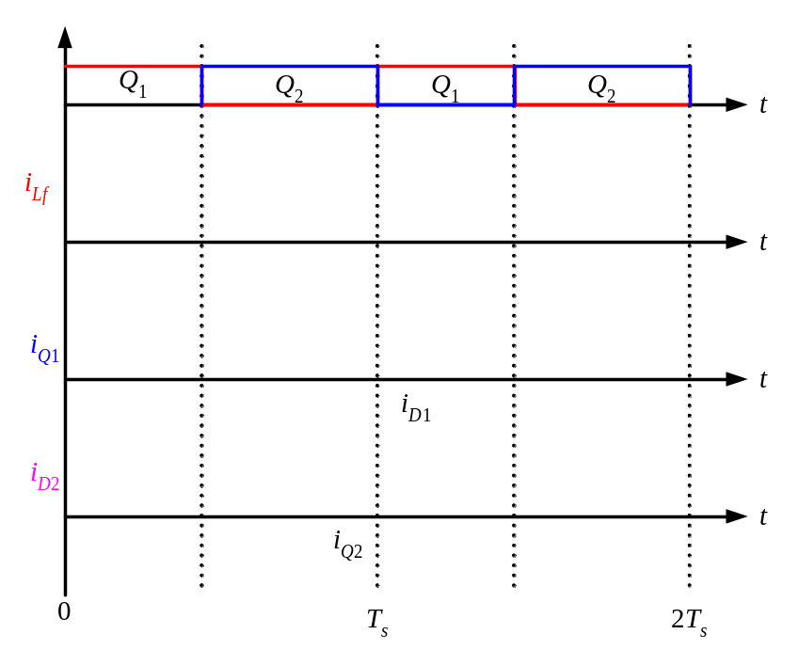
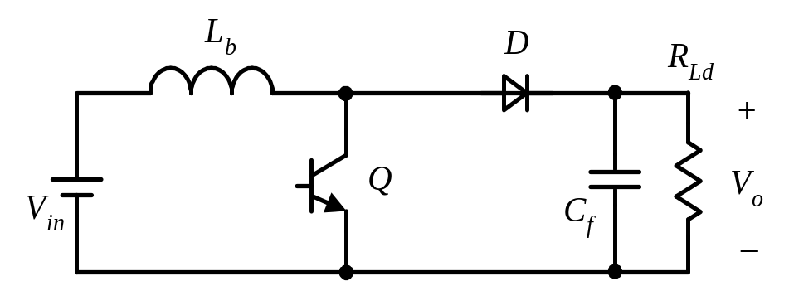
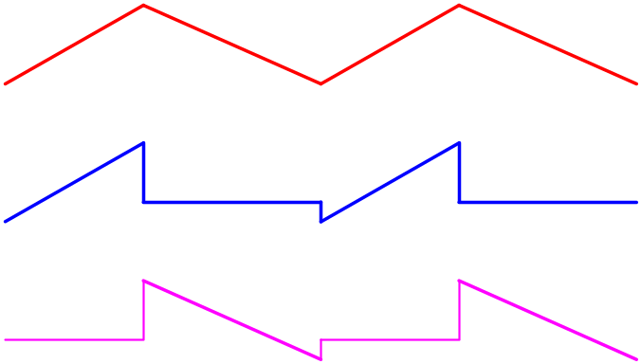
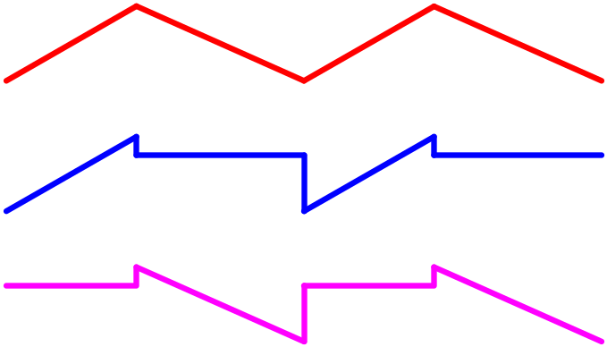
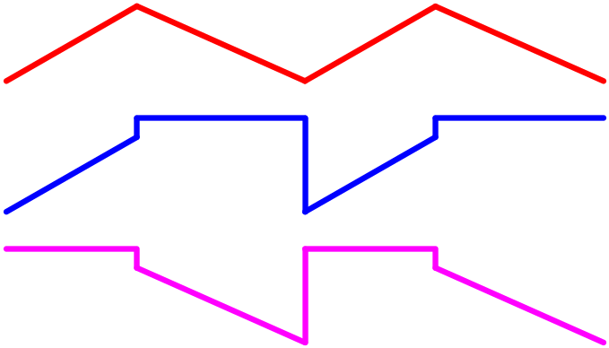
Buck Converter with Bi-Direction Switches
Power Flow

Slide 16
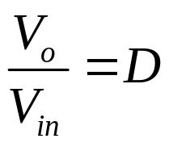
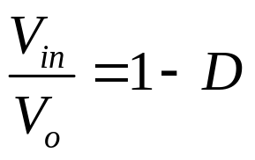
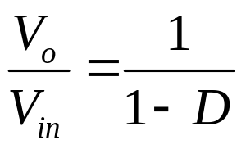
Voltage Conversion Ratio of Boost Converter
D is the duty cycle of Q₁
D is the duty cycle of Q₁
D is the duty cycle of Q₂

Slide 17
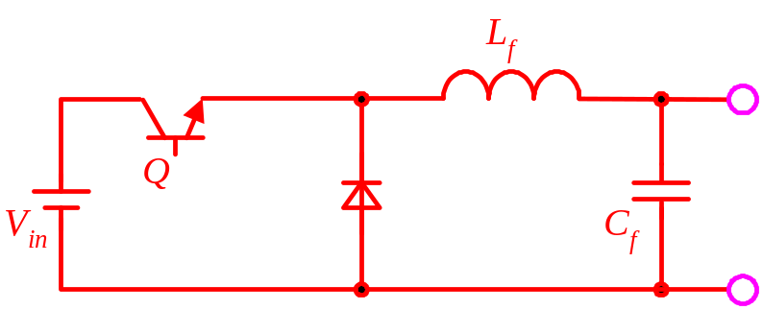
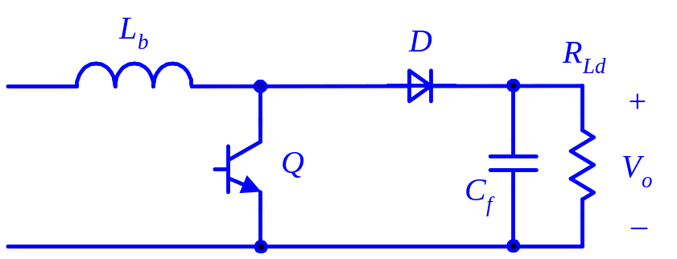
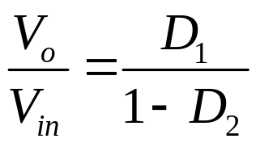
Why Buck-Boost Converter?
V_{o} < V_{in}
V_{o} > V_{in}

Slide 18
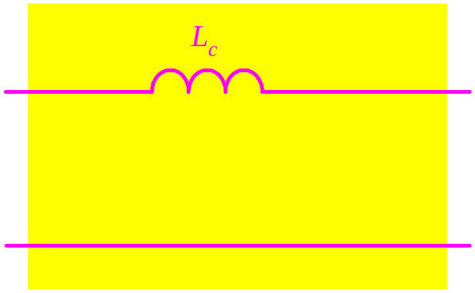
Simplification of Buck-Boost Converter (1)

Slide 19
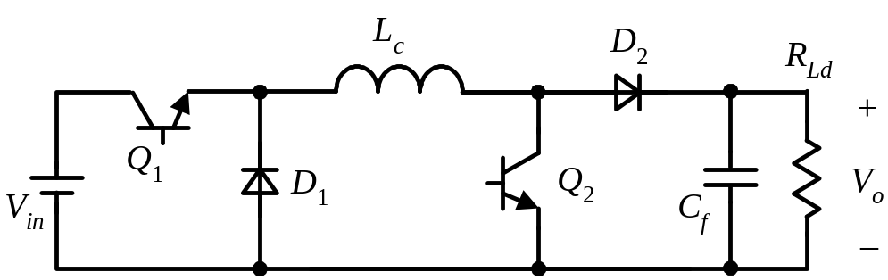
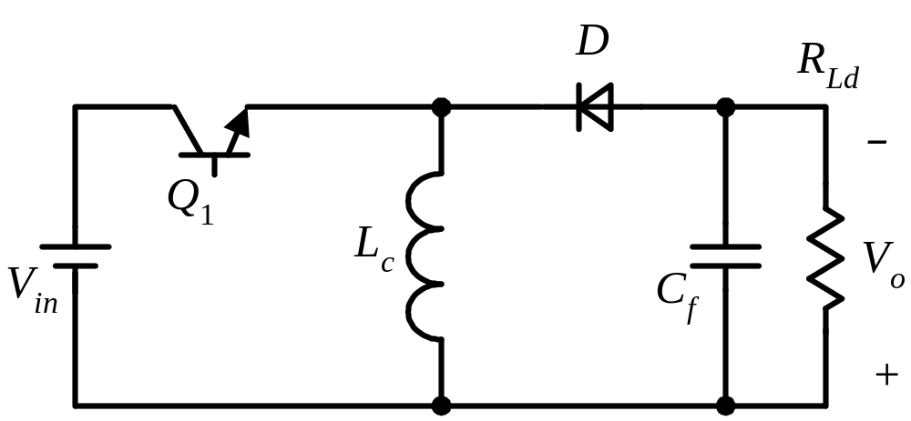
Simplification of Buck-Boost Converter (2)

Slide 20
Buck-Boost

Slide 21
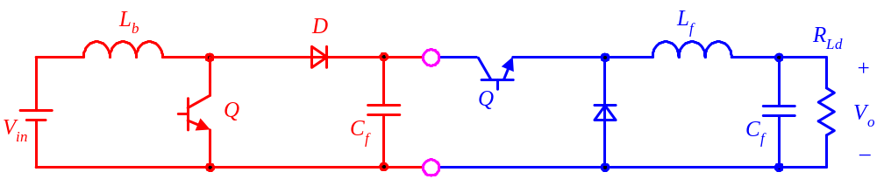
How to get Cuk?

Slide 22
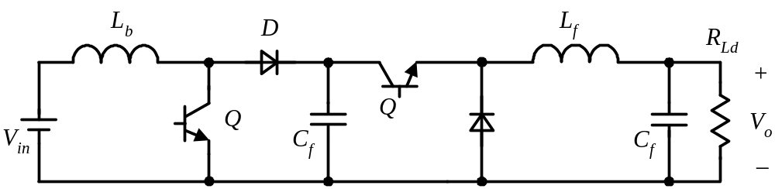
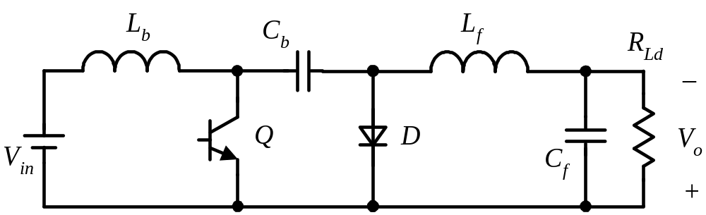
Equivalent of Cuk

Slide 23
Cuk

Slide 24
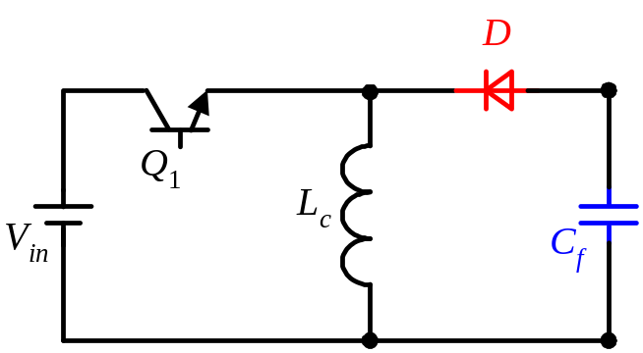
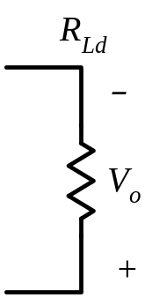
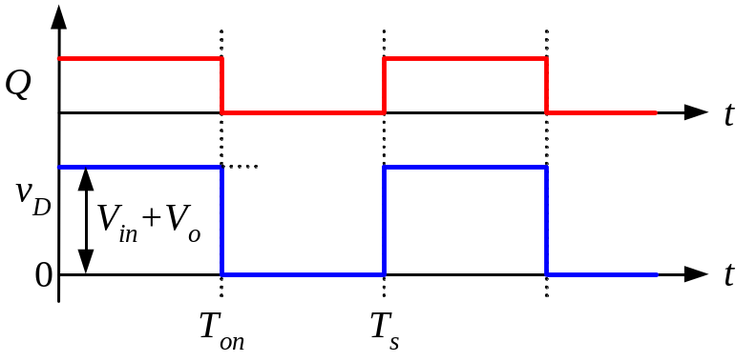
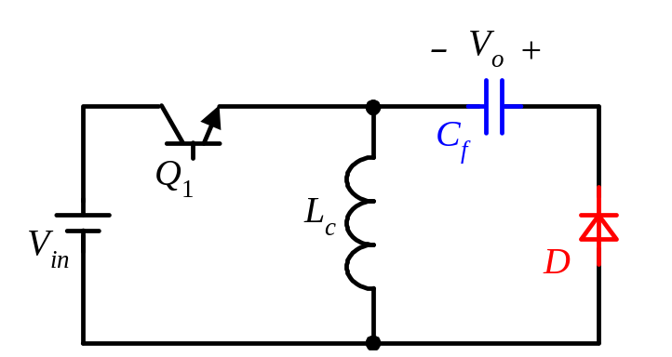
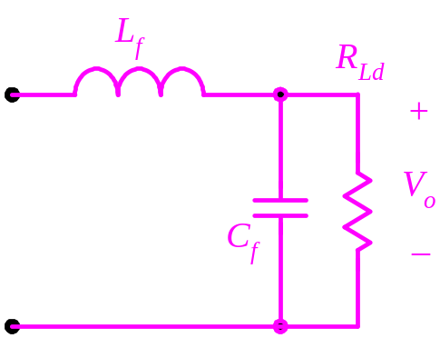

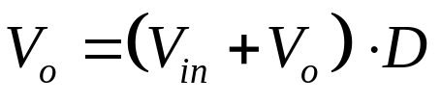
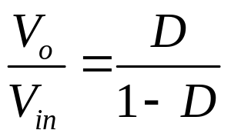
Derivation of Zeta

Slide 25
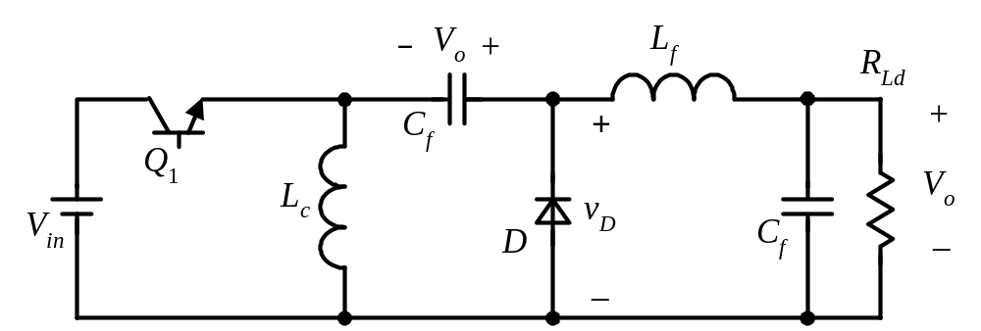
Zeta
Q开通
Q关断

Slide 26

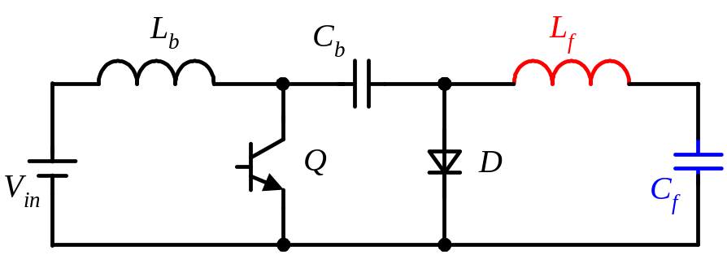
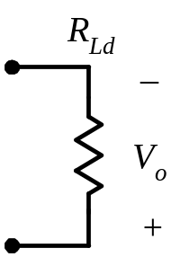

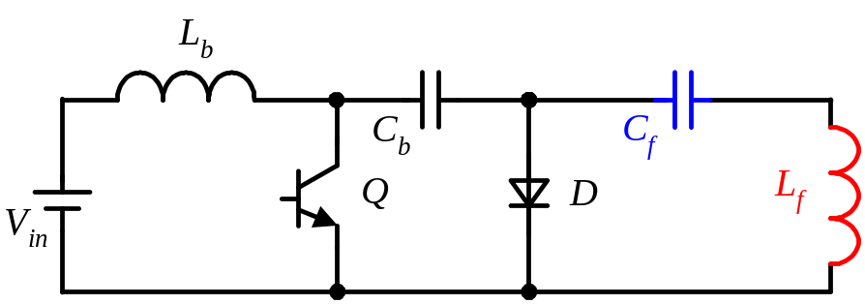
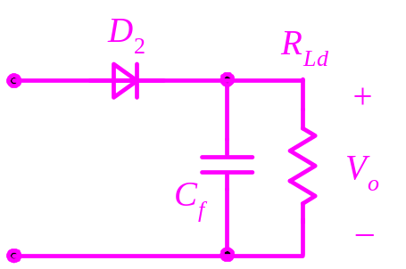
Derivation of Sepic (1)

Slide 27
Derivation of Sepic (2)

Slide 28

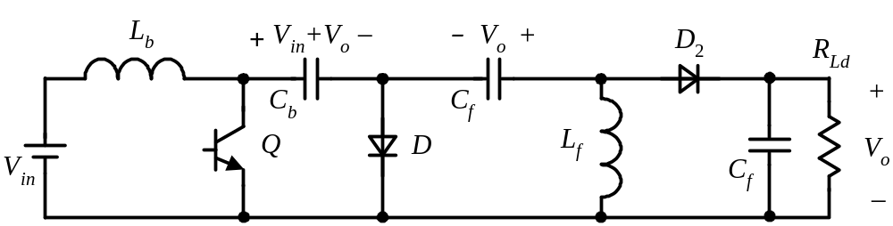

Derivation of Sepic (3)

Slide 29

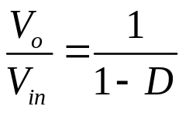
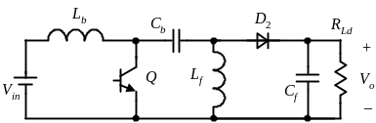
Comparison of the Converters
Voltage
Conversion
Ratio
Output
Voltage
Polarity
Input
Current Ripple
Output
Current Ripple
Converter
Topology
Configu-ration
Buck
+
Large
Small
Simple
Boost
+
Small
Large
Simple
_
Buck-
Boost
Large
Large
Simple
_
Cuk
Small
Small
Simple
Zeta
+
Large
Small
Complex
Sepic
+
Small
Large
Complex

